Slide 1
Medicate
Advance Software engineering 2017/18

Slide 2
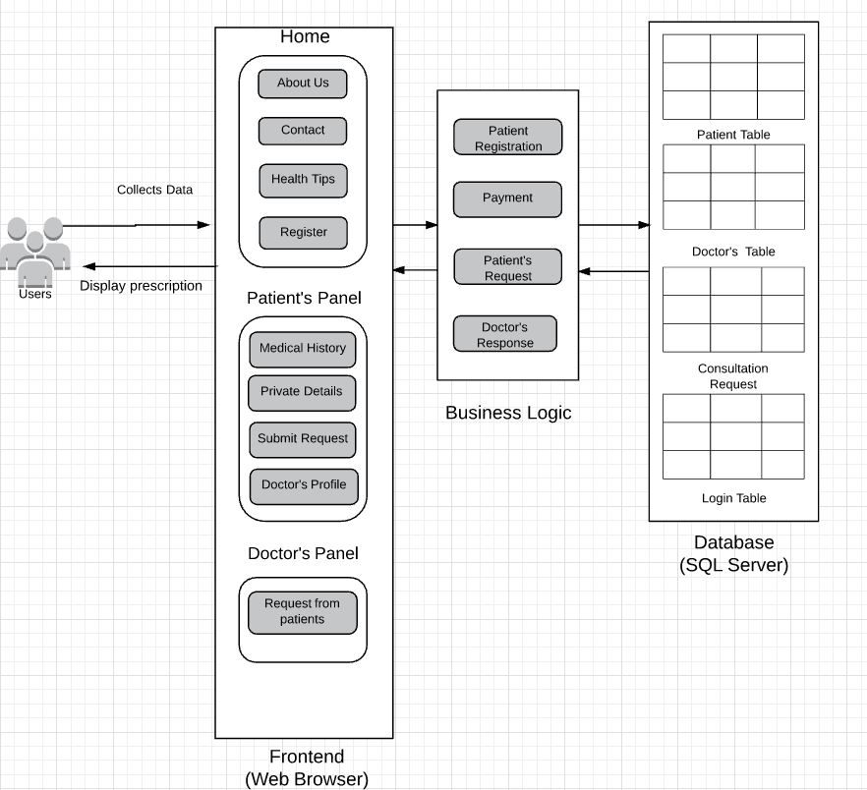
Architecture

Slide 3
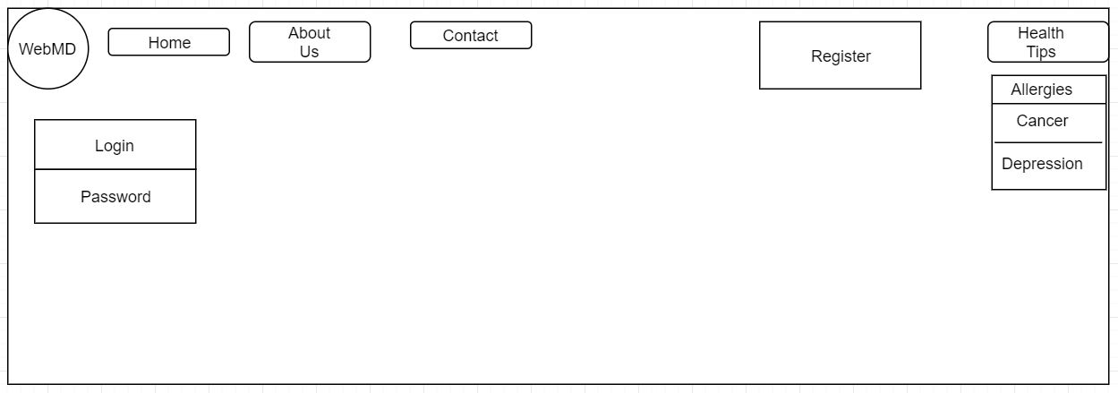
HOME PAGE

Slide 4
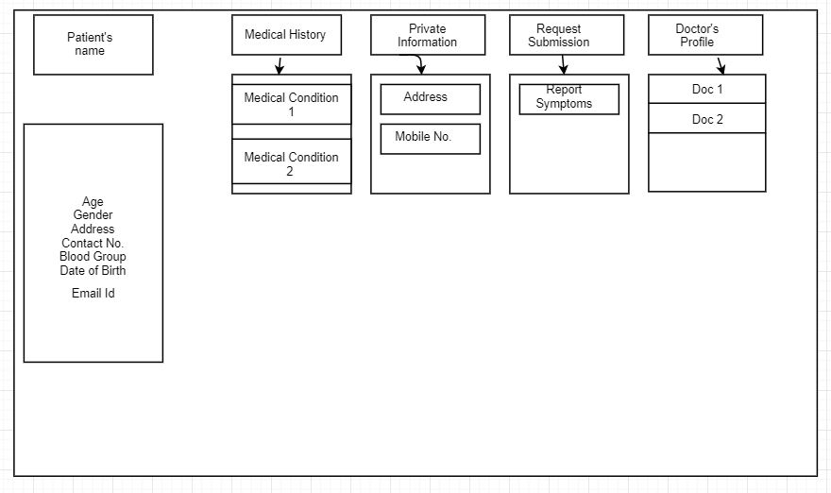
Patient Panel

Slide 5
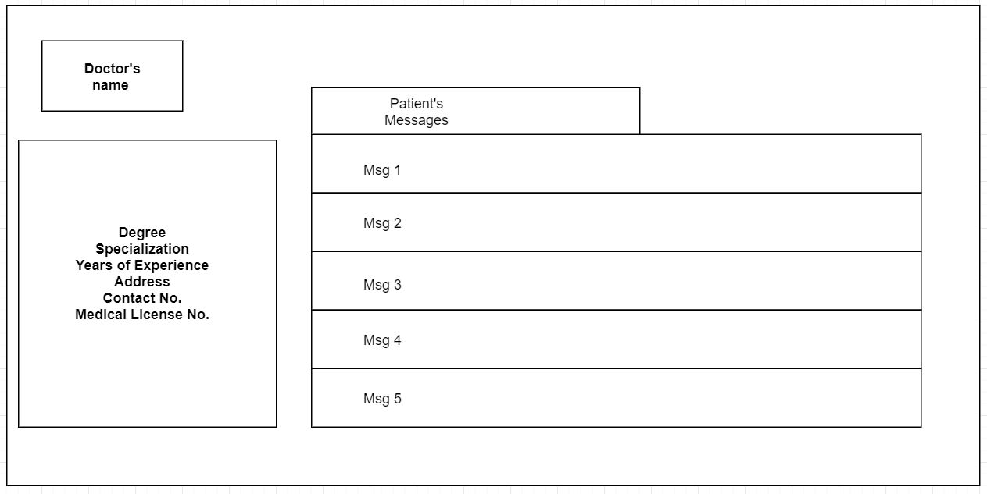
Doctor Panel

